Slide 1

STATISTICAL & PREDICTIVE ANALYTICS OF SOCCER PLAYERS

Slide 2



TEAM 2 – AIT614
JASON RAYEN
VISHAY PAKA
DHAVANI AVU
jrayen@gmu.edu
vpaka2@gmu.edu
davu@gmu.edu

Slide 3
01
ABSTRACT & RESEARCH AIM
ABSTRACT
RESEARCH AIM
02
DATA CLEANING - PYTHON
Agenda
03
EXPLORATORY DATA ANALYSIS - TABLEAU
04
DESCRIPTIVE STATISTICAL ANALYSIS
STATISTICAL ANALYSIS IN R
STATISTICAL ANALYSIS IN NoSQL (MONGODB)
05
PREDICTIVE MODELING - PySpark MLIB & PANDAS

Slide 4
ABSTRACT
The research work involves a comprehensive, detailed study about the FIFA players. Their characteristics are taken into account and the rating of each of the player is being studied and predicted. The main aim of the research is to study the participation of players from every other country, the major predictors for the output column, get statistical analysis of how the data is distributed and finally predict the rating of the players. This useful research can help team managers to select the required players for their team based on what information they have. We have a lot of methods which have been used over here which team managers can use to get what they require.
The initial phase focuses on data cleaning which is the major part of the research, we have addressed all the missing values, and the dataset has been further statistically analyzed to get all the required information from the data. This analysis involves creating histograms, performing skewness check and checking the significance of variables. The project also involves the use of Exploratory Data Analysis which addresses and helps team managers to look through players of specific region or specific characteristics. Through graphical representations, we gain a nuanced understanding of how player characteristics are distributed across different variables, aiding in feature selection for subsequent modelling.
With all the information we have got from analysis, the prediction modelling is done on the dataset. We have made use of 11 algorithms and the best algorithm has been chosen. Multiple Linear Regression, Support Vector Machine – Kernel and Linear, Lasso and Ridge models, Decision Trees Regression, Random Forest Algorithm, K-Nearest Neighbors, Polynomial Regression and Artificial Neural Network. All these algorithms were done using Spark MLIB and Pandas in databricks for effective use of spark clusters in dealing with big data.
Several technologies were used in this research. The whole research was coded in databricks with Python, R, NoSQL and tableau. The data cleaning part was done in Python, Exploratory Data Analysis was done in Tableau and Python, Descriptive Statistics was done in R and NoSQL and Predictive Modelling was done in PySpark MLIB and Pandas.
Results were astonishing as we were able to get the best r-squared value with low RMSE and MAE with 2 algorithms, Artificial Neural Network and Polynomial Regression. We have selected ANN as the best algorithm for this research, but people can use polynomial regression as well if they want to stick with machine learning and not use deep learning. We have received a r-squared value of 0.89 with Artificial Neural Network and 0.88 with polynomial regression.

Slide 5
AIM OF RESEARCH
Can we predict the player’s rating based on the available features ? What algorithms were tested and which one had the highest prediction accuracy ?
What are the desirable features required for performing predictive analysis ? How are you so confident about these features and why ? Confirm the same with Statistical Analysis with proper reasoning ?
Explain the distribution of data for all variables with descriptive statistical visualizations ? Why is the data distributed in this way. What is the reason for the distribution ?
Do we have any correlation between every other variable ? Do we have to remove any variable’s before applying the model fit ?
Can you prepare an interactive dashboard/visualizations describing the distribution of data ?

Slide 6
EXPLORATORY DATA ANALYSIS

Slide 7
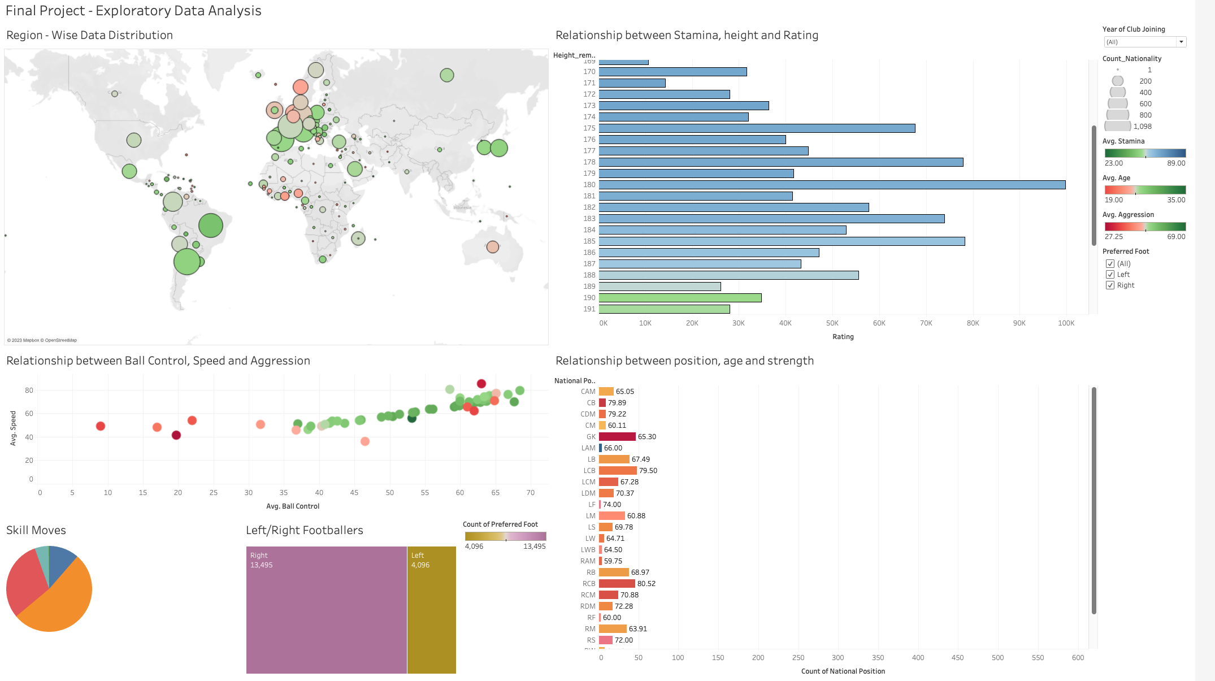

Slide 8
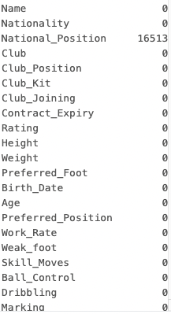
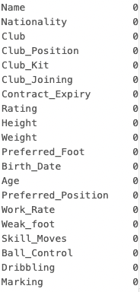
DATA CLEANING
Data Cleaning is done in Python where the null values are removed and the data distribution to be used is defined.
CLEANED DATASET ->

Slide 9
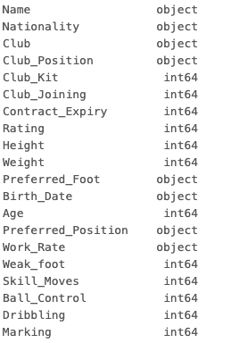
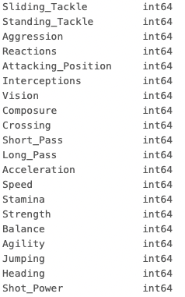
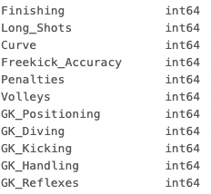
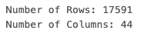
DATA CLEANING
The National_Position column was removed as it had all the values as NULL.
Height and Weight column had ‘cm’ and ‘kg’ in it were subset of the columns were taken.
Data Type of certain columns were changed to objects and others where kept as integers.
'Club_Position','Name', 'Nationality','Club','Birth_Date','Preferred_Position', 'Work_Rate’ are removed from the dataset as they are not required.

Slide 10
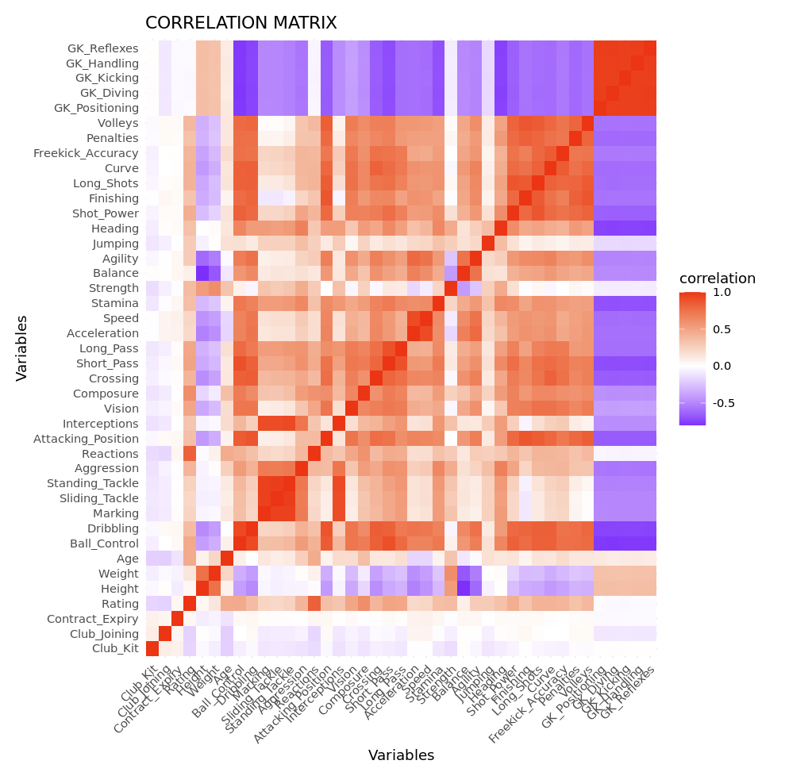
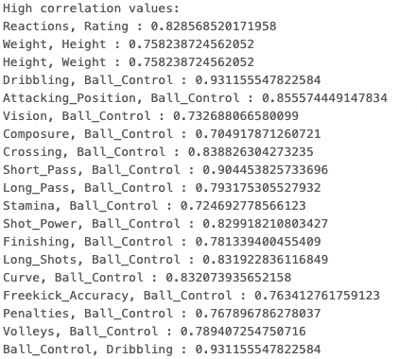
CORRELATION ANALYSIS
STATISTICAL ANALYSIS - R
CORRELATION ANALYSIS

Slide 11
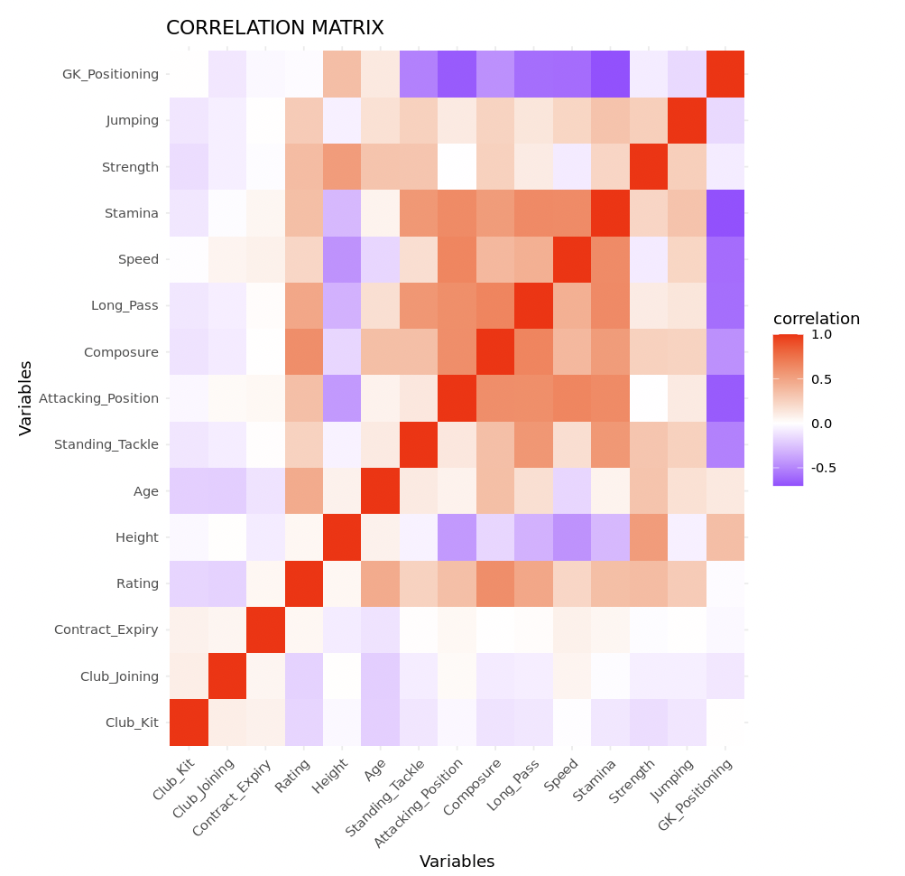
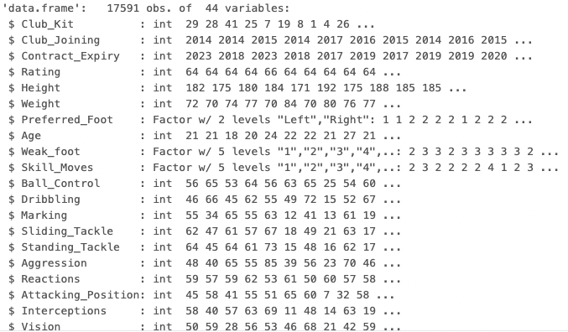
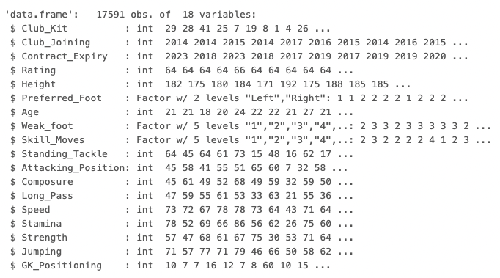
BEFORE AND POST CORRELATION ANALYSIS

Slide 12
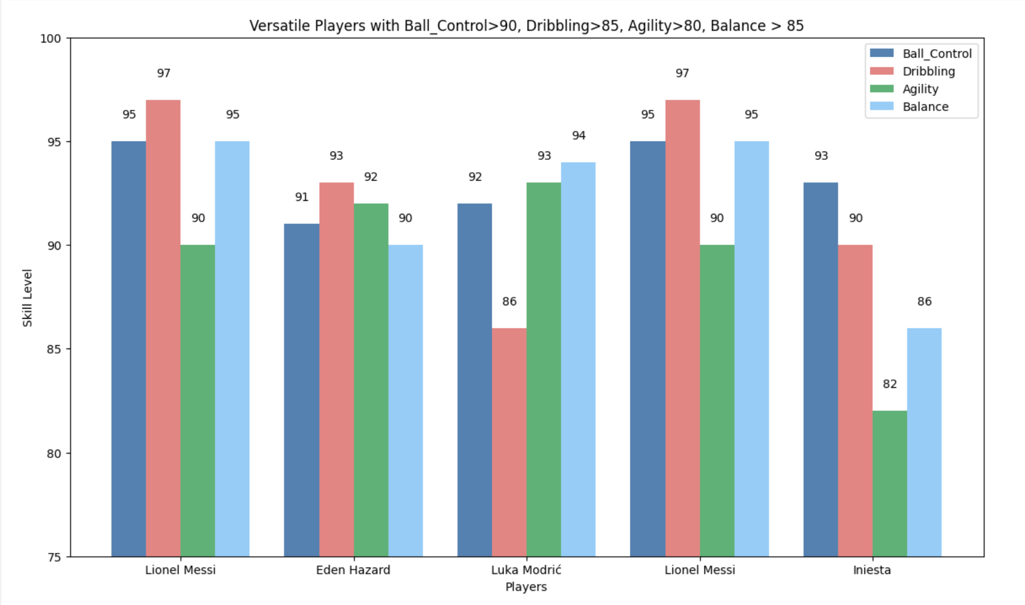
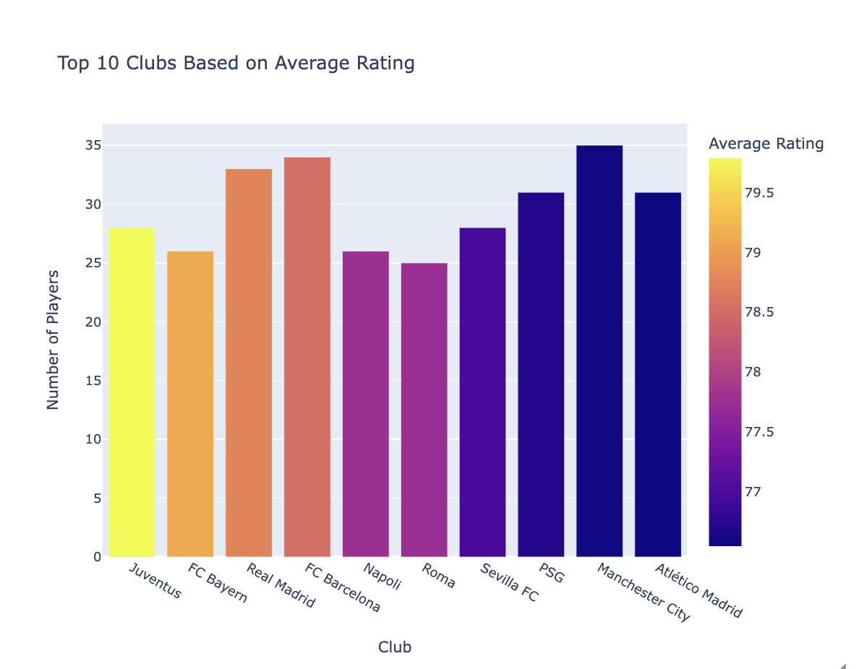
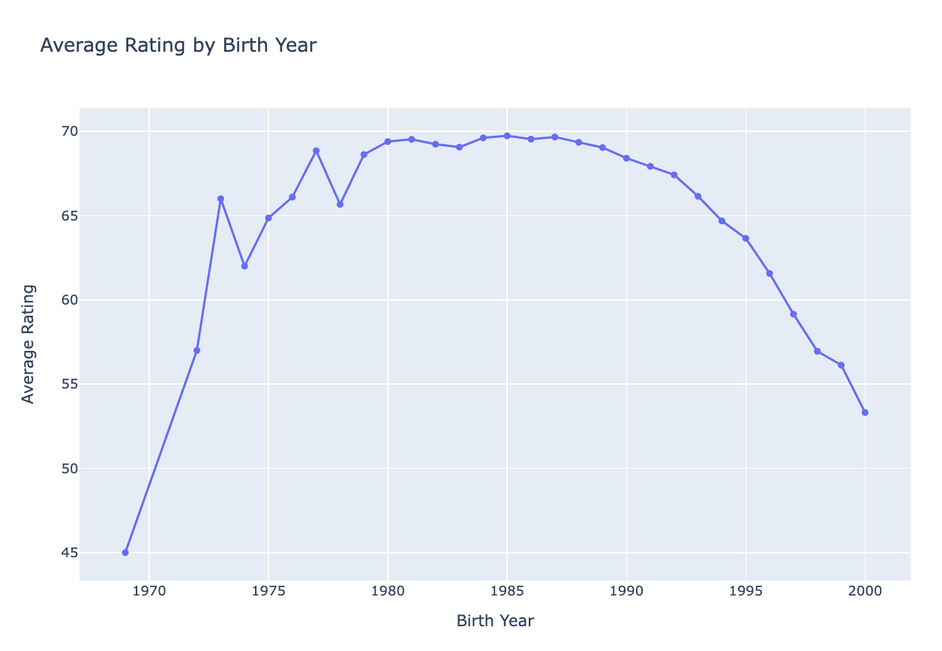
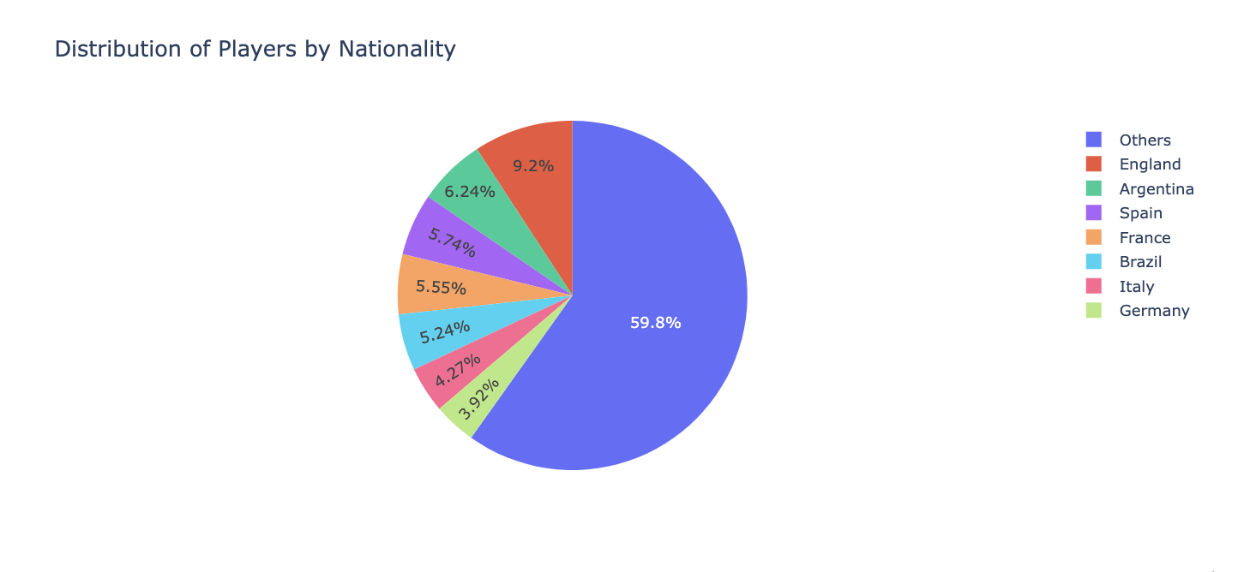

Slide 13
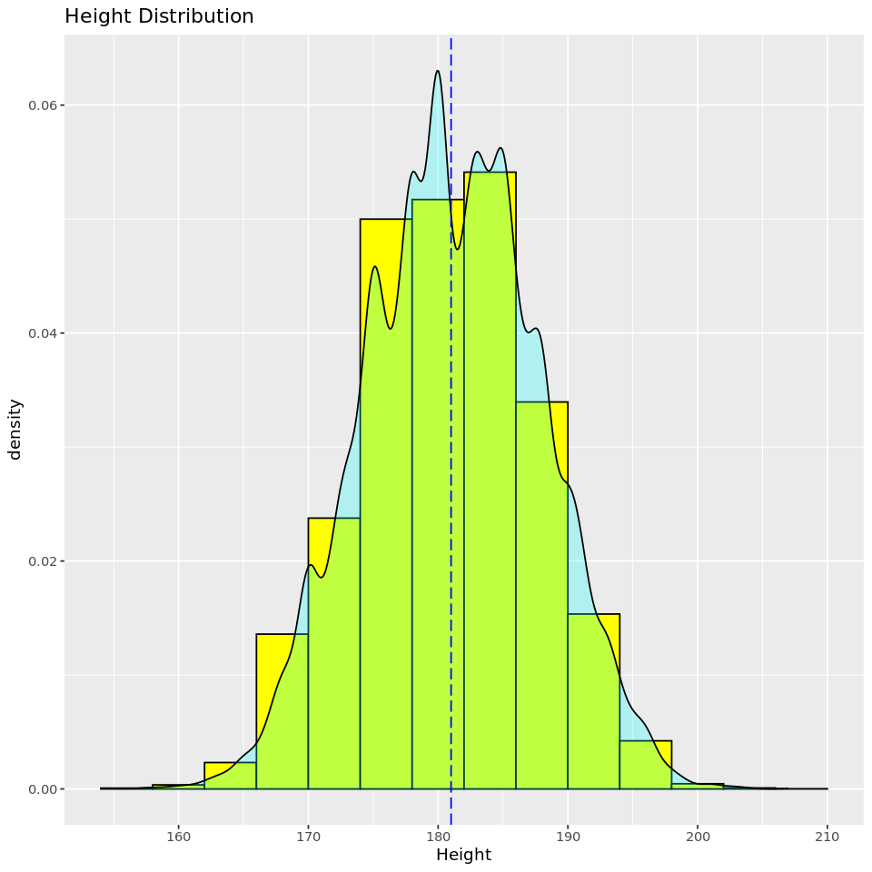
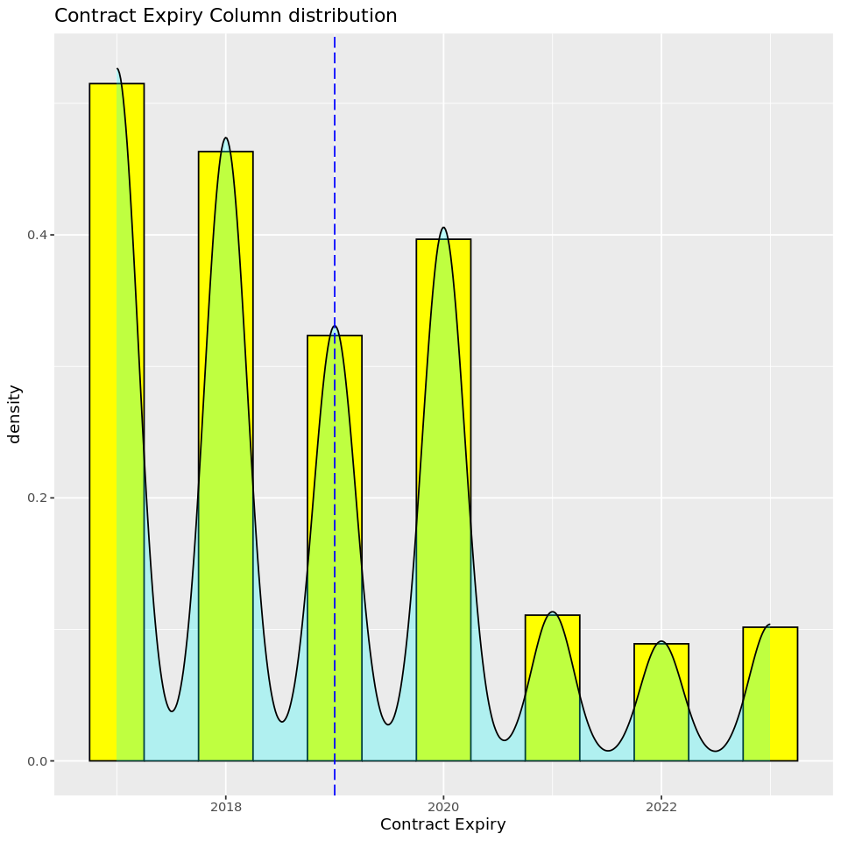
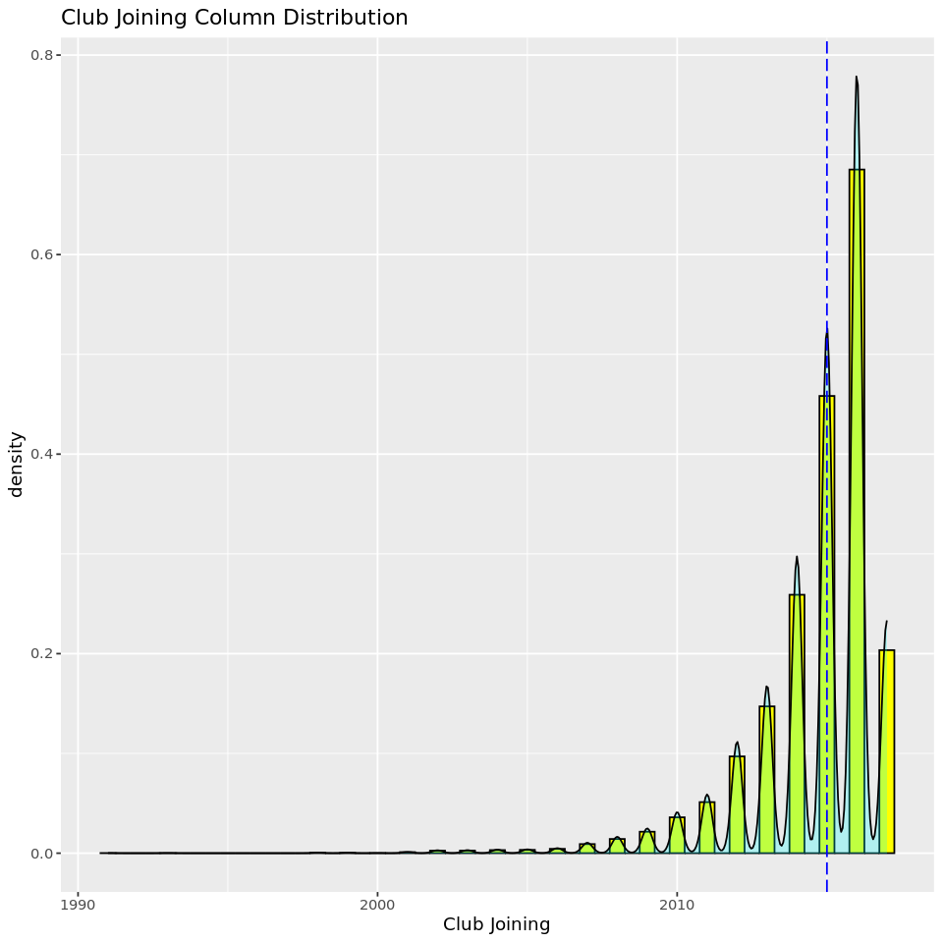
STATISTICAL ANALYSIS - HISTOGRAMS

Slide 14
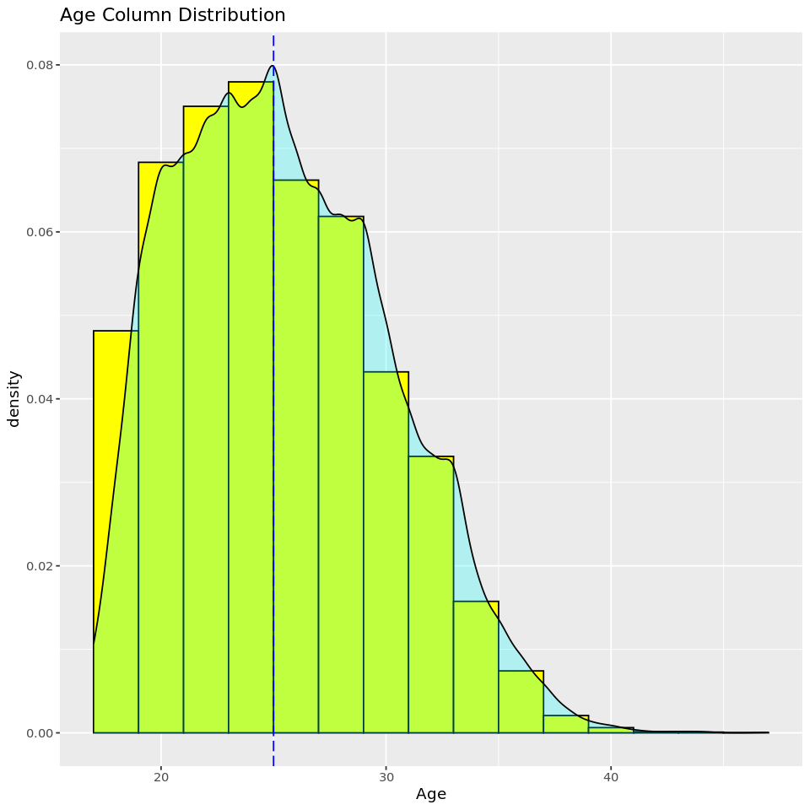
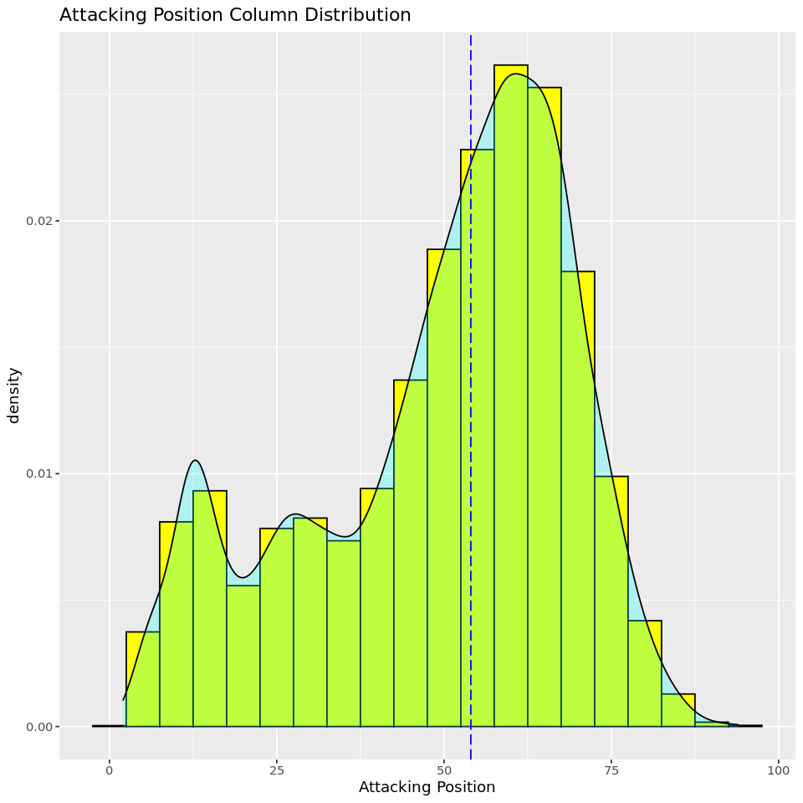
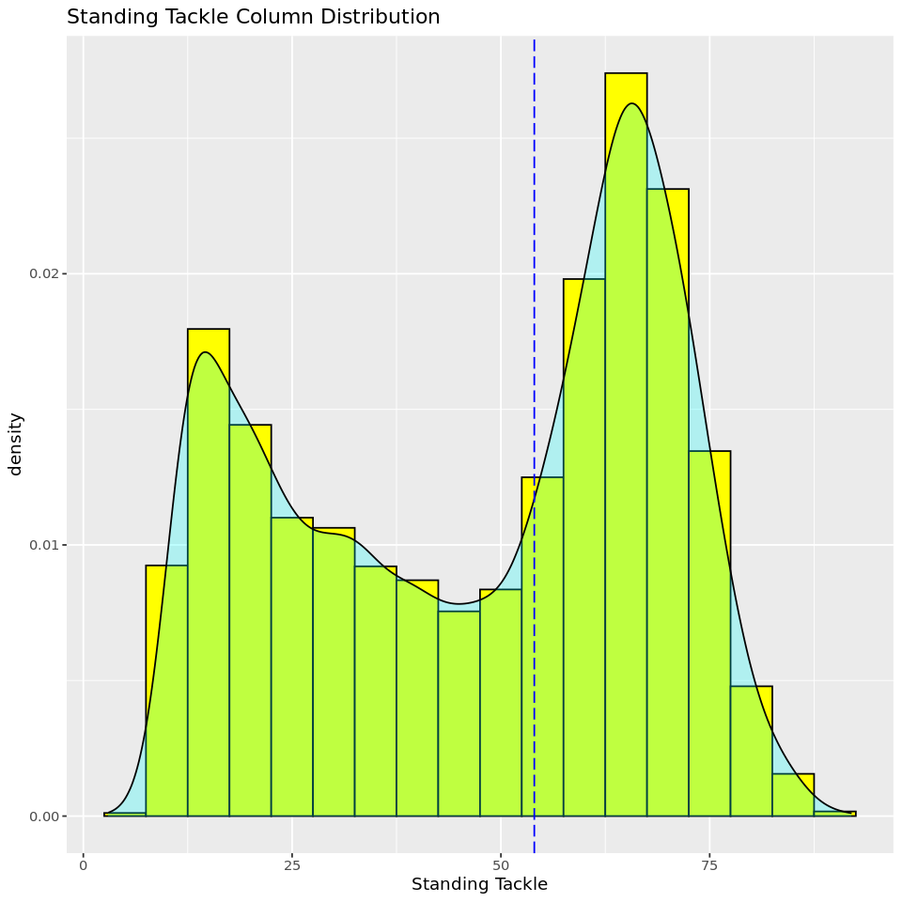
STATISTICAL ANALYSIS - HISTOGRAMS

Slide 15
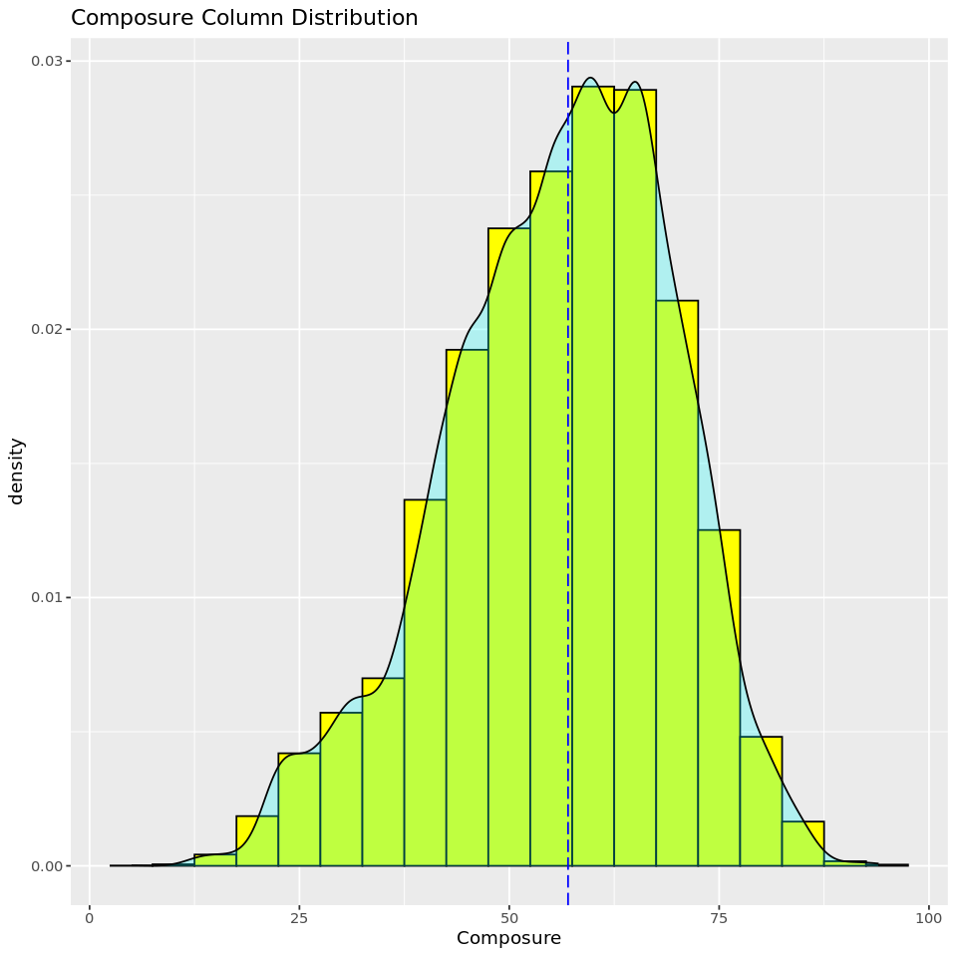
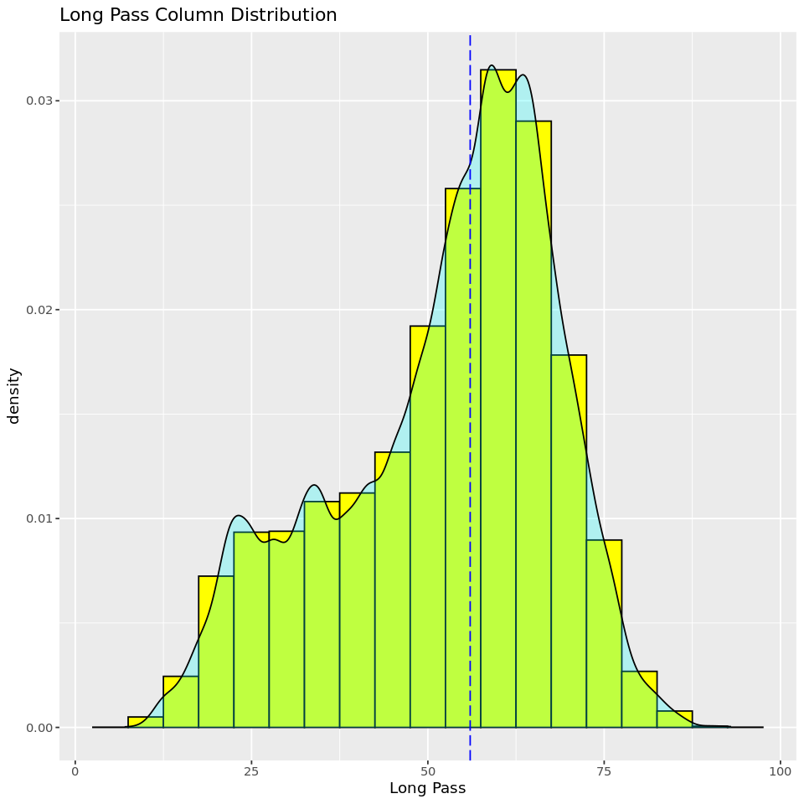
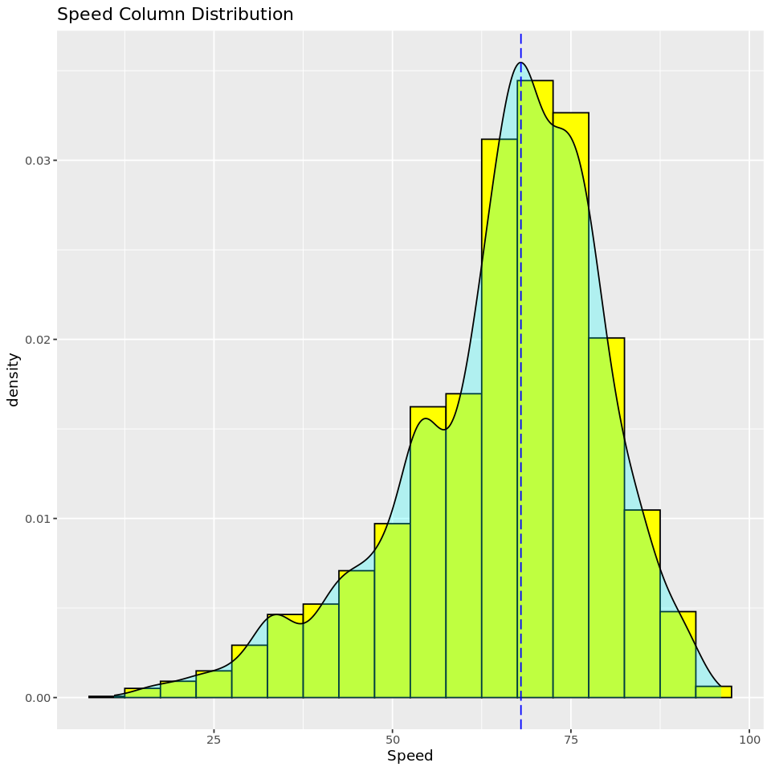
STATISTICAL ANALYSIS - HISTOGRAMS

Slide 16
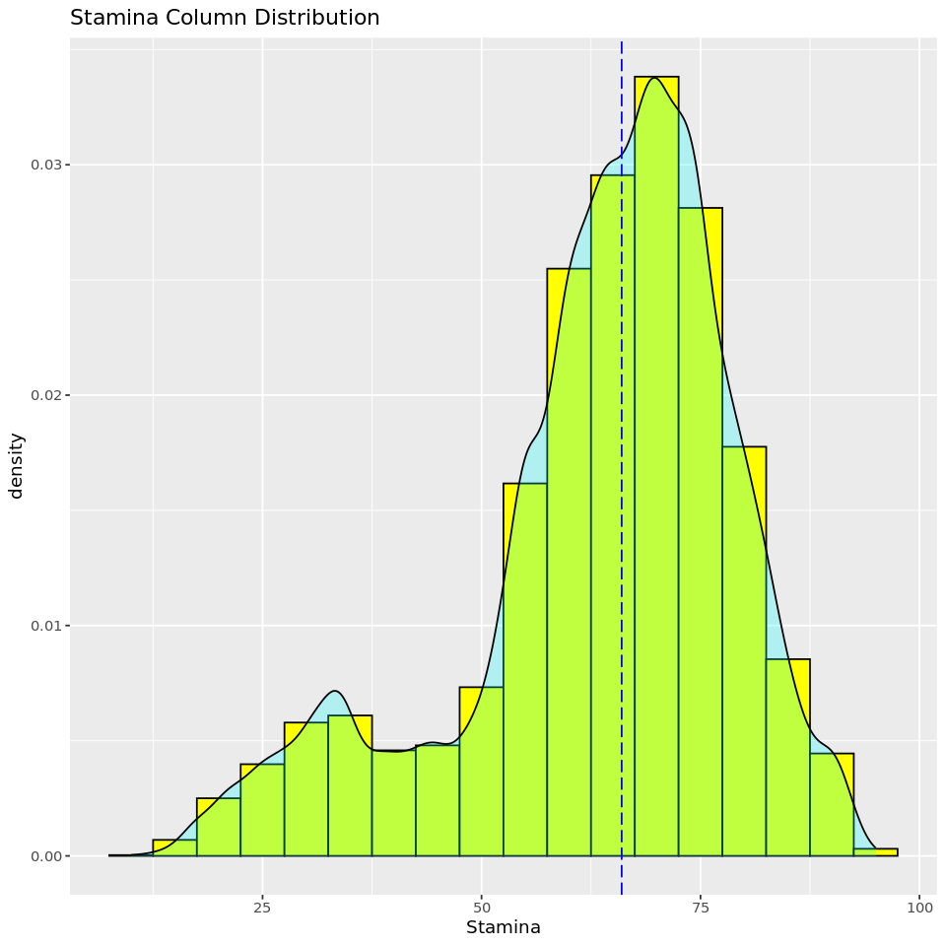
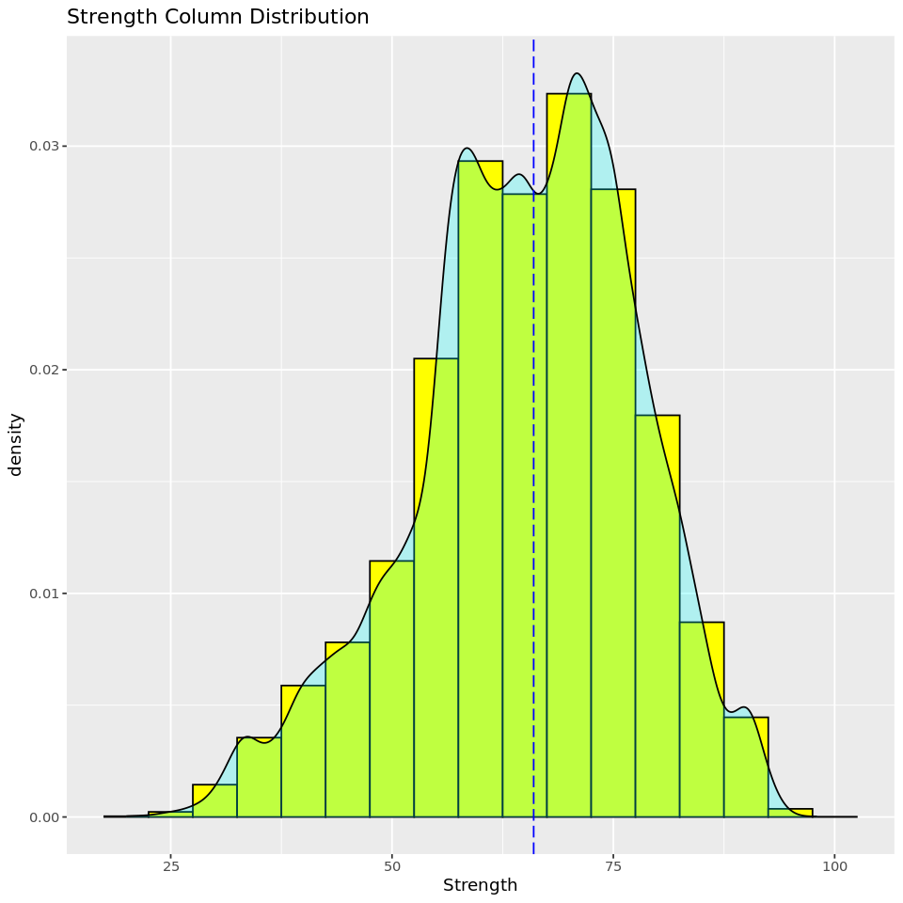
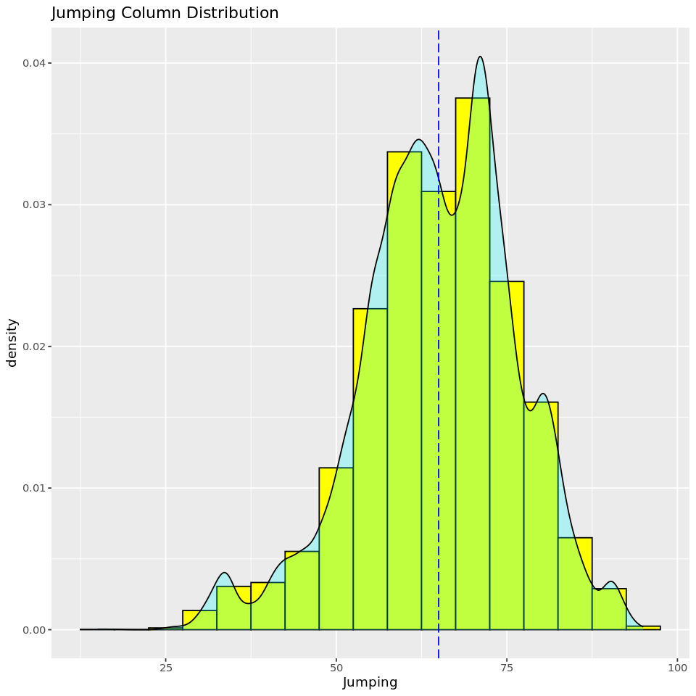
STATISTICAL ANALYSIS - HISTOGRAMS

Slide 17
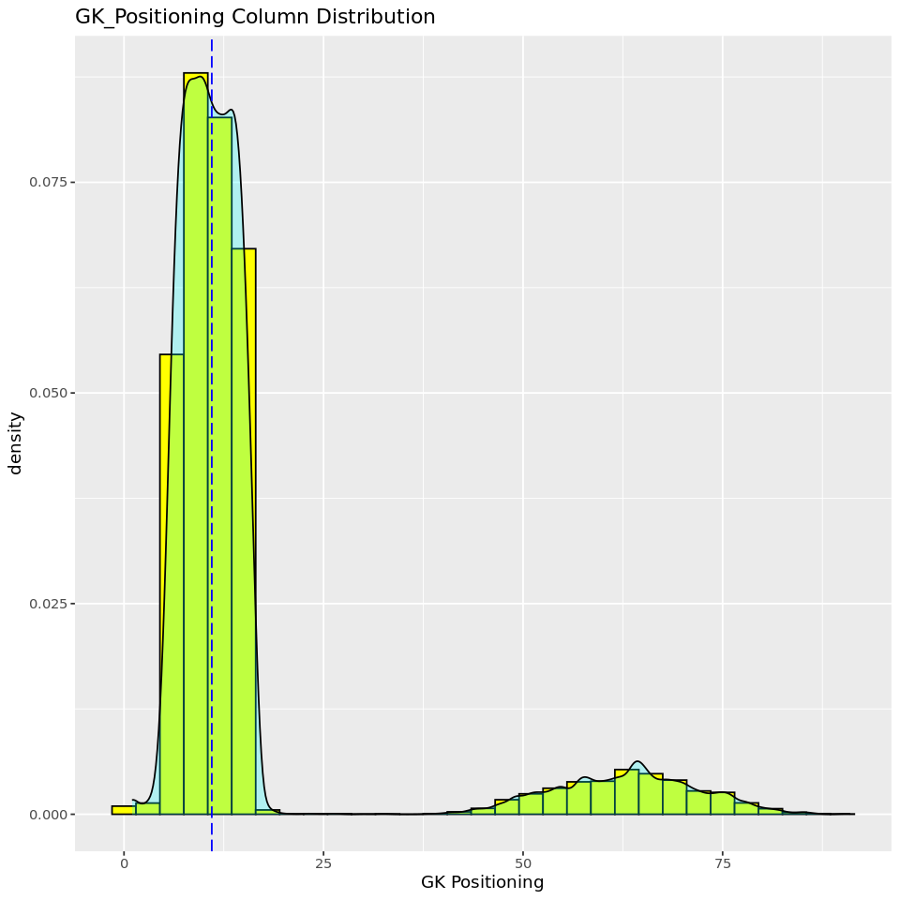
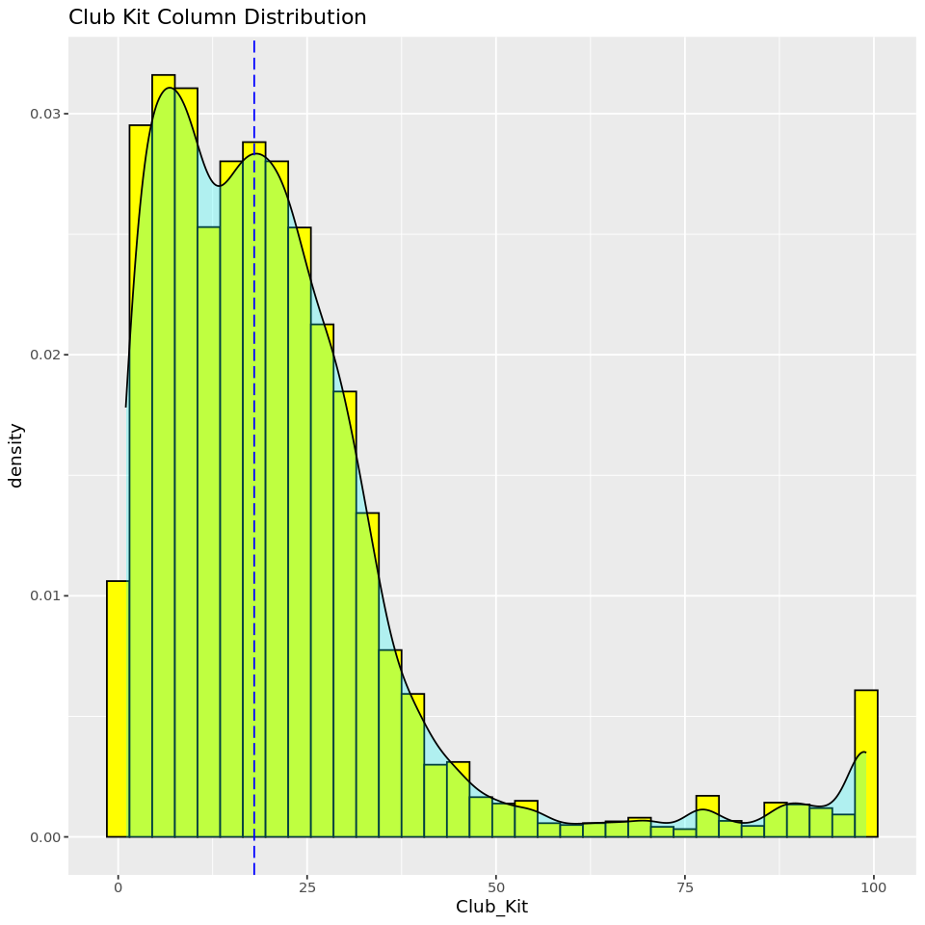
STATISTICAL ANALYSIS - HISTOGRAMS

Slide 18
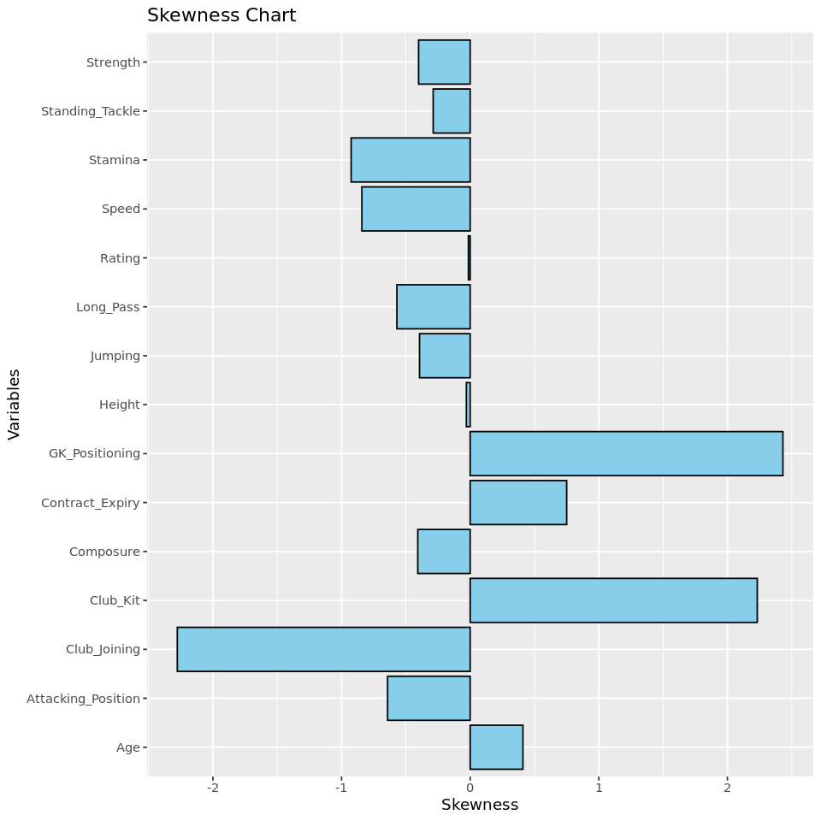
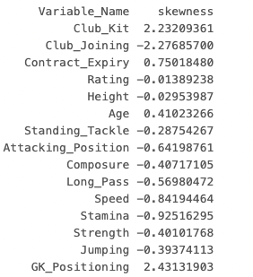
STATISTICAL ANALYSIS – SKEWNESS CHECK

Slide 19
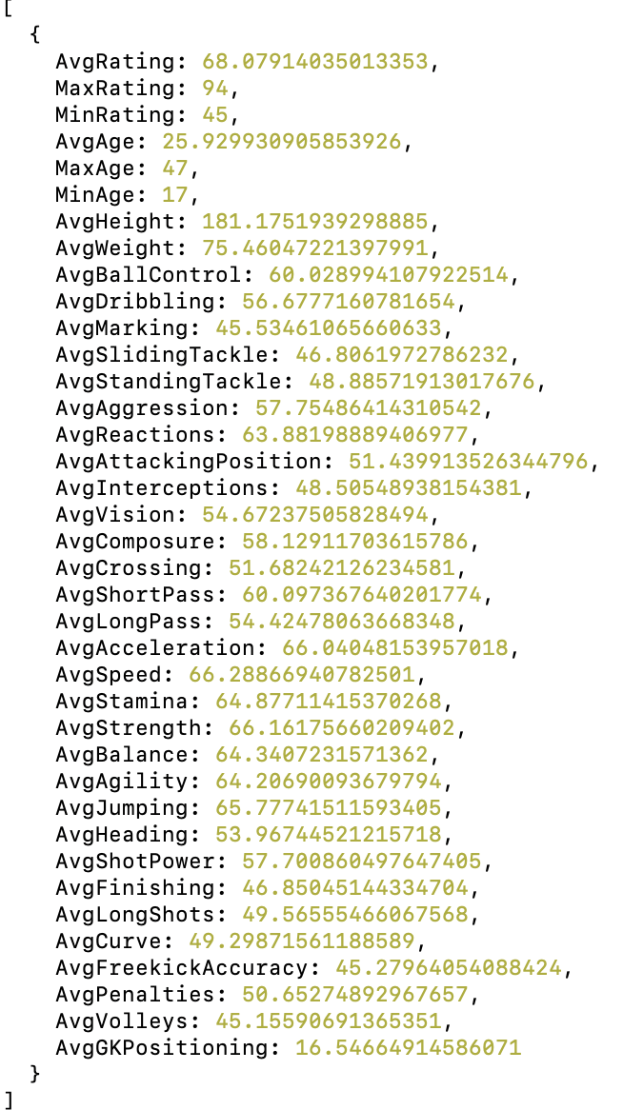
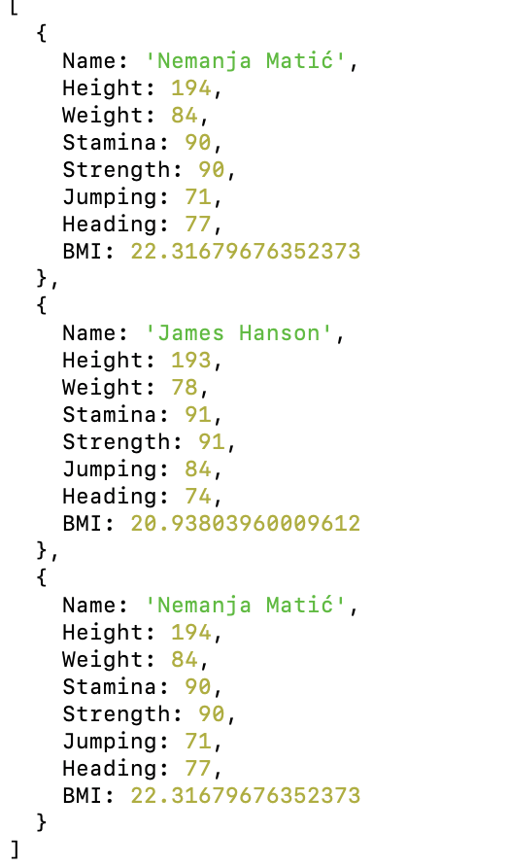
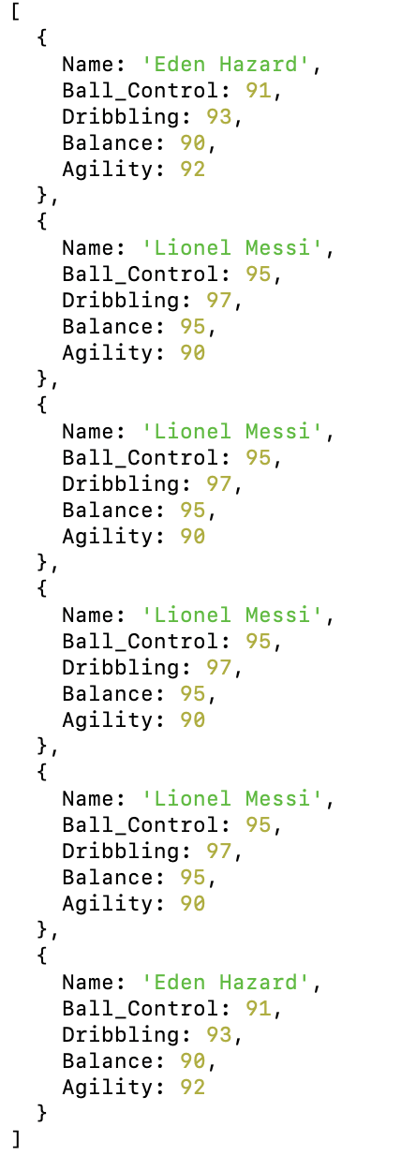
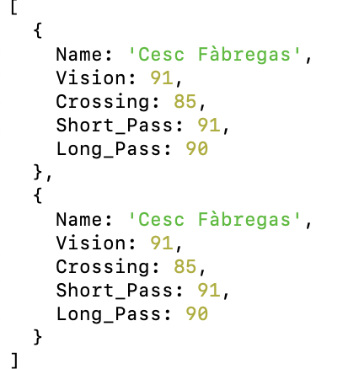
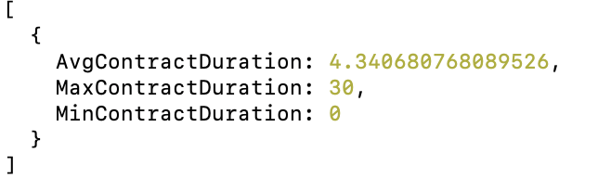
Statistics Analysis Using NOSQL
Players statistical analysis
Players with good fitness
Players with Exceptional Shooting Skills
Players with Versatile Skills
Contract duration analysis

Slide 20
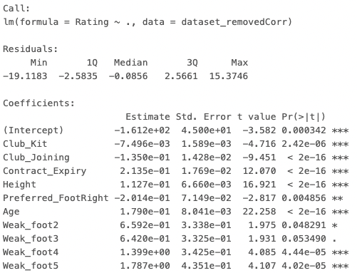
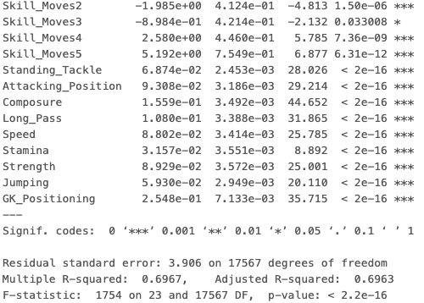
STATISTICAL ANALYSIS – SIGNIFICANCE CHECK
All variables are significant over here.
There is less significance for Weak_foot3 and Skill_Moves3
which can be ignored as they are part of the Factor Variables.

Slide 21
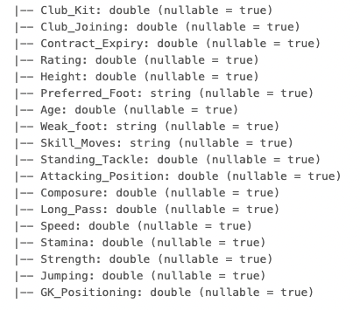
FINAL DATASET

Slide 22
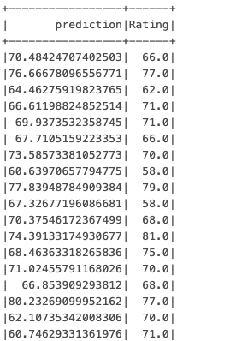
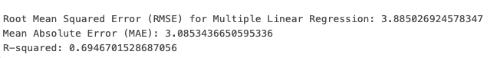
Multiple linear regression- unscaled

Slide 23
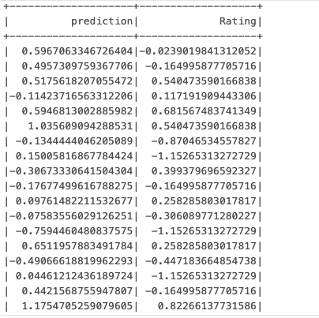
Multiple linear regression- scaled

Slide 24
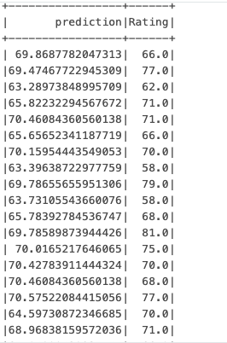
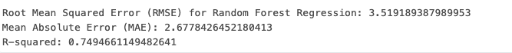
Random Forest Regression Algorithm

Slide 25
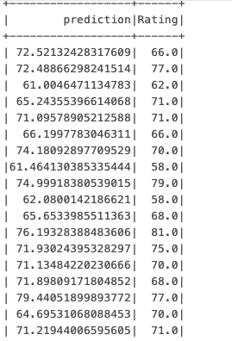
Support Vector Machine (Kernel Model) - Non Linear Version

Slide 26
K-Nearest Neighbors (KNN)

Slide 27
Polynomial Regression

Slide 28
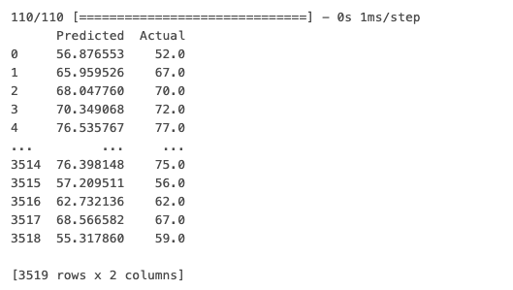
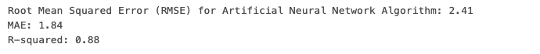
Artificial Neural Network Algorithm

Slide 29
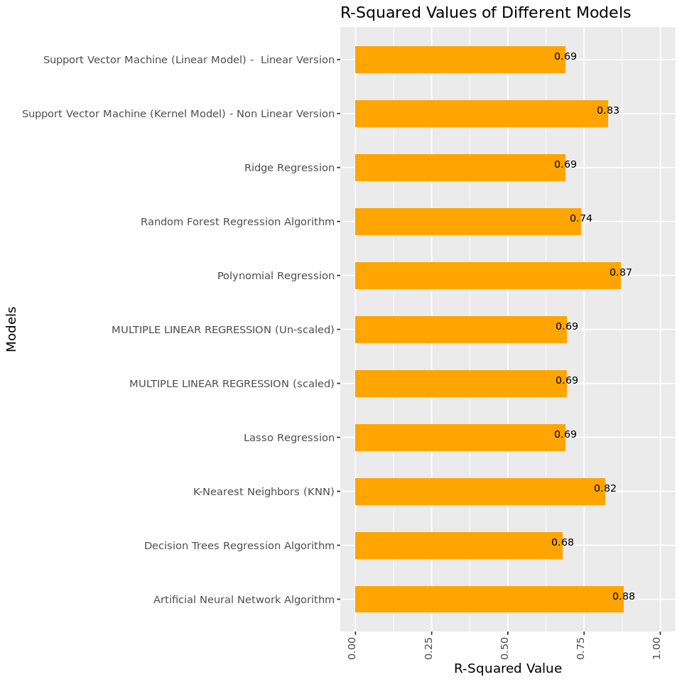
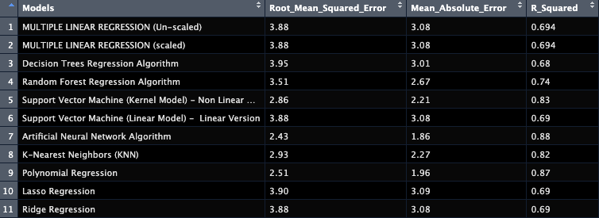
PREDICTIVE MODELING

Slide 30
CONCLUSION
To conclude, We can select Artificial Neural Network and Polynomial regression as the best models with low rmse and mae values and high r-squared value. As a final choice, we select ANN as the best model but if the research is to be made easy like with low run time, we can select polynomial regression model as the best model.
The final aim was to use all possible models and derive the best for the problem and we were able to derive it with 2 algorithms.
The effective use of EDA and DS helped us to understand the distribution of data, what to be done, what variables to be removed and because of statistical analysis, our predictive modelling part became much easier to code.
The EDA dashboard can be used to get spot results of whatever specific characteristic information is required.
Basically, We can use this research for 2 different types of predictions. One which was the final aim, The overall rating prediction and another one with the EDA dashboard specific variable predictions based on region, and other characteristics.

Slide 31
TECHNOLOGIES USED
DATA CLEANING – PYTHON
EXPLORATORY DATA ANALYSIS – TABLEAU
EXPLORATORY DATA ANALYSIS – PYTHON
DESCRIPTIVE STATISTICS – R
DESCRIPTIVE STATISTICS – NoSQL (MongoDB)
PREDICTIVE MODELLING – PySpark MLIB and PANDAS

Slide 32
FUTURE WORK
A prediction model can be developed which is a website having the best model running in the background. User can input data and we can get the rating being predicted which might be more useful.
ANN model can be tested with different number of hidden layers and different activation function to get a better accuracy of the prediction.
Run Time of some of the algorithms can be reduced by suitable methods.

Slide 33
Lessons learnt
Several lessons have been learnt from class and now.
Effective use of algorithms have been learnt.
New technologies which were never used before were used here such as databricks, Tableau and NoSQL.
Got stunning results and various ideas were implemented to improve the prediction performance.
Got knowledge of several other technologies such as IOT, etc.
Thanks to Dr. Lindi Liao for such an exciting course.

Slide 34
REFERENCES
H. Wen, S. Li, U. o. E. S. a. T. o. C. C. C. Wei Li School of Computer Science and Engineering, J. Li and C. Yin, "Comparision of Four Machine Learning Techniques for the Prediction of Prostate Cancer Survivability," [Online]. Available: https://ieeexplore-ieee-org.mutex.gmu.edu/document/8632577.
S. M. Hasan, M. F. Rabbi and N. Jahan, "Can Machine Learning Technique Predict the Prostate Cancer accurately?: The fact and remedy," [Online]. Available: https://ieeexplore-ieee-org.mutex.gmu.edu/document/9641099.
M. I. B., M. Alam, N. I. U. C. o. E. a. E. T. D. I. U. Mansour Tahernezhadi Electrical Engineering, H. K. Vege and P. Rajesh, "https://ieeexplore-ieee-org.mutex.gmu.edu/document/9208240," [Online]. Available: https://ieeexplore-ieee-org.mutex.gmu.edu/document/9208240.
BLACKBOARD. (n.d.). Retrieved from Upload Assignment: RM2: Collaborative Learning Assignment : https://mymasonportal.gmu.edu/ultra/courses/_495372_1/cl/outline
Dr. Liao’s Code Examples & Tutorials: Blackboard/Liao_PySpark_basic_databricks.html

Slide 35


